Slide 1
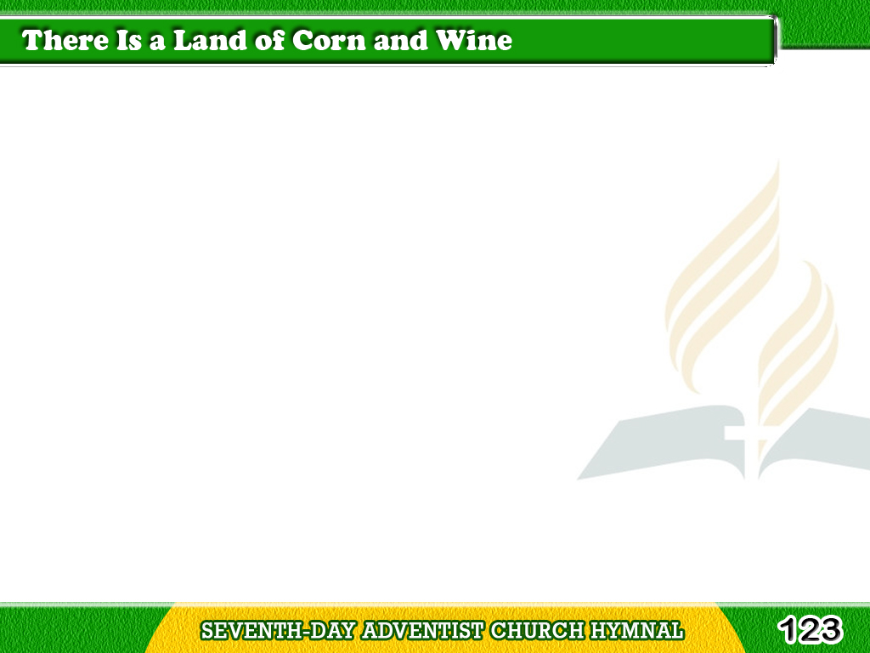
1/4
There is a land
of corn and wine,
And all its joys
will soon be mine;
Tagalog
Version

Slide 2
1/4
There shines undimmed
one blissful day,
For earth’s dark night
has passed away.
Tagalog
Version

Slide 3
1/4
Chorus
O Beulah land!
Sweet Beulah land!
Upon thy heights I long to stand,
And view the radiant, jasper sea,
Tagalog
Version

Slide 4
1/4
Chorus
And mansions fair,
prepared for me,
And find on that eternal shore
My heaven, my home,
forevermore.
Tagalog
Version

Slide 5
2/4
My Saviour then will
walk with me;
O sweet communion that will be!
He’ll gently lead me by the hand,
In that celestial, happy land.
Tagalog
Version

Slide 6
2/4
Chorus
O Beulah land!
Sweet Beulah land!
Upon thy heights I long to stand,
And view the radiant, jasper sea,
Tagalog
Version

Slide 7
2/4
Chorus
And mansions fair,
prepared for me,
And find on that eternal shore
My heaven, my home,
forevermore.
Tagalog
Version

Slide 8
3/4
A sweet perfume
upon the breeze,
Will come from
ever vernal trees,
Tagalog
Version

Slide 9
3/4
And flowers that never
fading grow,
Where streams of life
forever flow.
Tagalog
Version

Slide 10
3/4
Chorus
O Beulah land!
Sweet Beulah land!
Upon thy heights I long to stand,
And view the radiant, jasper sea,
Tagalog
Version

Slide 11
3/4
Chorus
And mansions fair,
prepared for me,
And find on that eternal shore
My heaven, my home,
forevermore.
Tagalog
Version

Slide 12
4/4
The zephyrs then
will laden be
With sounds of
sweetest melody,
Tagalog
Version

Slide 13
4/4
As angels,
with the ransomed throng,
Join in the sweet
redemption song.
Tagalog
Version

Slide 14
4/4
Chorus
O Beulah land!
Sweet Beulah land!
Upon thy heights I long to stand,
And view the radiant, jasper sea,
Tagalog
Version

Slide 15
4/4
Chorus
And mansions fair,
prepared for me,
And find on that eternal shore
My heaven, my home,
forevermore.
Tagalog
Version

